Slide 1
Virtualization for the Masses
Fernando Russ (fruss@coresecurity.com)
BDLV / #229
05-15-2009

Slide 2
Some random definitions…
“Virtualization
A method of partitioning one physical server computer into multiple “virtual” servers, giving each the appearance and capabilities of running on its own dedicated machine.
”
VS
“emulation
An emulator duplicates (provides an emulation of) the functions of one system using a different
system, so that the second system behaves like
(and appears to be) the first system..
”

Slide 3
QUIZ
how old is virtualization ?
(
)
Some hints…
32Bit addressing
Virtual Memory

Slide 4
The obvious response
~ 42 years OLD
( From 1966 )

Slide 5
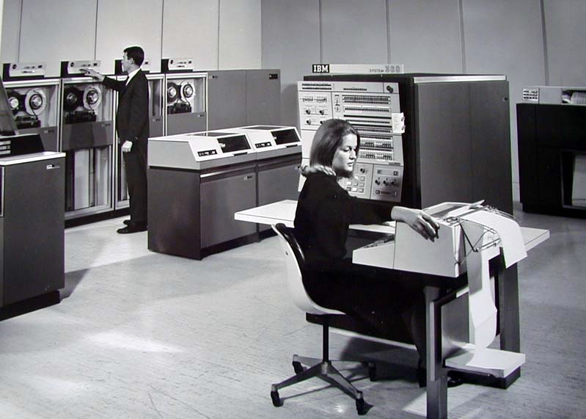
A very portable system…
‘66
IBM System/360 Model 67 (S/360-67)
Some features:
Full Virtualization Support
Runs CP67/CMS as OS
The DIAG instruction

Slide 6
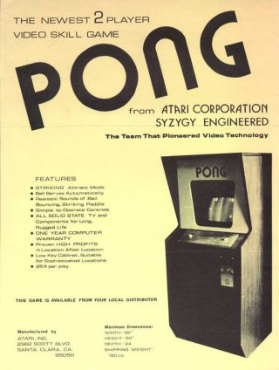
Powered by OpenGL
‘73
“Application and analysis of the virtual machine approach to information system security and isolation”
Stuart E. Madnick
John J. Donovan
1973

Slide 7
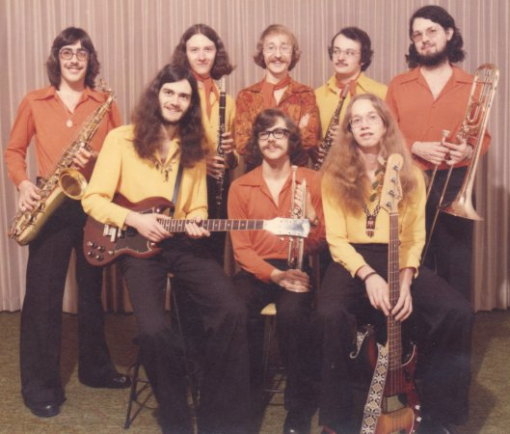
They parents are brothers?
‘74
"Formal Requirements for Virtualizable Third Generation Architectures”
Gerald J. Popek
Robert P. Goldberg
1974

Slide 8
~ 35 years later

Slide 9
Con la virtualizacion se come, se educa y se cura!
The big Hype

Slide 10





Full of Money
Big players
Revenue: US $ 1.9 Billons
Employees: 6500
Closed Source
Innoteck➔Sun➔Oracle
Open Source
Fabrice Bellard
Open Source

Slide 11

Bruce’s Skills
Virtualization
Techniques
Dynamic Recompilation
Hot Patching
Emulation
Hardware Assisted
The magic behind VMware

Slide 12
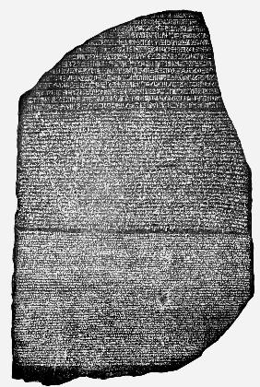
Lost in translation
Dynamic Recompilation
x86
.data # section declaration
msg:
.string "Hello, world!\n"
len = . - msg # length of our dear string
.text # section declaration
# we must export the entry point to the ELF linker or
.global _start # loader. They conventionally recognize _start as their
# entry point. Use ld -e foo to override the default.
_start:
# write our string to stdout
movl $len,%edx # third argument: message length
movl $msg,%ecx # second argument: pointer to message to write
movl $1,%ebx # first argument: file handle (stdout)
movl $4,%eax # system call number (sys_write)
int $0x80 # call kernel
# and exit
movl $0,%ebx # first argument: exit code
movl $1,%eax # system call number (sys_exit)
int $0x80 # call kernel

Slide 13
Lost in translation
Dynamic Recompilation
PPC
.data # section declaration - variables only
msg:
.string "Hello, world!\n"
len = . - msg # length of our dear string
.text # section declaration - begin code
.global _start
_start:
# write our string to stdout
li 0,4 # syscall number (sys_write)
li 3,1 # first argument: file descriptor (stdout)
# second argument: pointer to message to write
lis 4,msg@ha # load top 16 bits of &msg
addi 4,4,msg@l # load bottom 16 bits
li 5,len # third argument: message length
sc # call kernel
# and exit
li 0,1 # syscall number (sys_exit)
li 3,1 # first argument: exit code
sc # call kernel

Slide 14
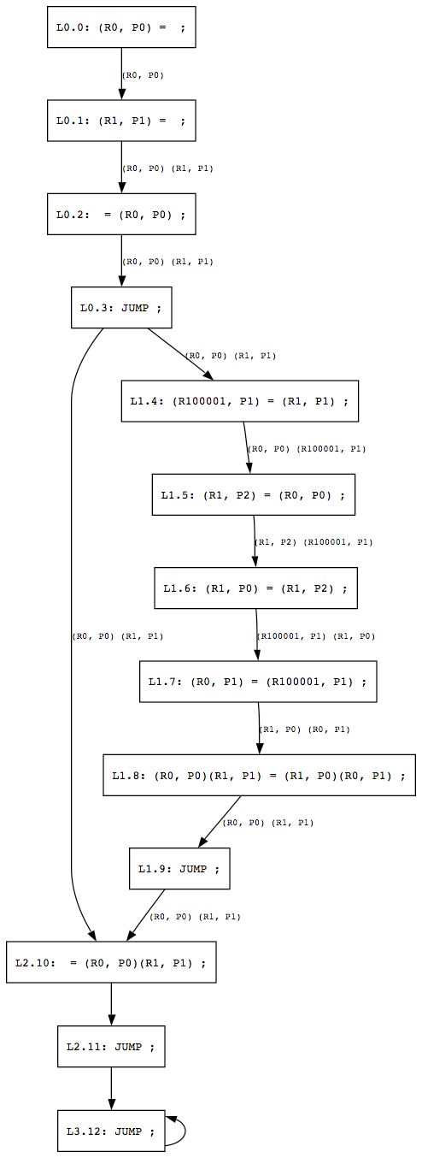


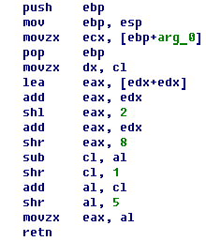
Shaken, not stirred
Hot patching

Slide 15

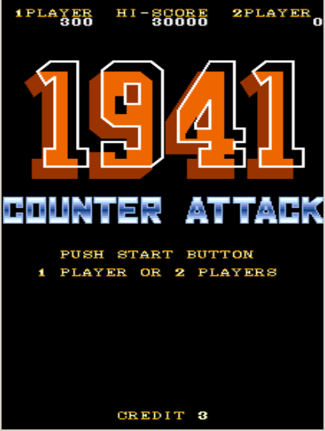

Warranty avoiders
Emulation

Slide 16



Fast!
Hardware Assisted
VT-d
VT-x
AMD-v
CP

Slide 17
Warranty avoiders
Hardware Assisted
Llamen a NICO!

Slide 18
Matanga! fruss
(fruss@coresecurity.com)

